Slide 1
Chapter 1:
Semiconductor Diodes

Slide 2

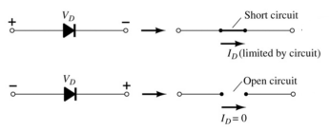
Diodes
The diode is a 2-terminal device.
A diode ideally conducts in only one direction.

Slide 3
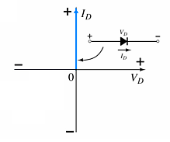
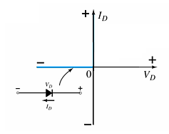
Diode Characteristics
Conduction Region
Non-Conduction Region
The voltage across the diode is 0 V
The current is infinite
The forward resistance is defined as
R_{F} = V_{F} / I_{F}
The diode acts like a short
All of the voltage is across the diode
The current is 0 A
The reverse resistance is defined as R_{R} = V_{R} / I_{R}
The diode acts like open

Slide 4
Semiconductor Materials
Materials commonly used in the development of semiconductor devices:
Silicon (Si)
Germanium (Ge)
Gallium Arsenide (GaAs)

Slide 5
Doping
The electrical characteristics of silicon and germanium are improved by adding materials in a process called doping.
There are just two types of doped semiconductor materials:
n-type
p-type
n-type materials contain an excess of conduction band electrons.
p-type materials contain an excess of valence band holes.

Slide 6
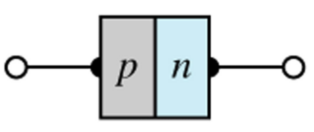
p-n Junctions
One end of a silicon or germanium crystal can be doped as a p-type material and the other end as an n-type material.
The result is a p-n junction.

Slide 7
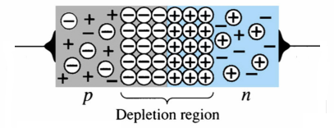
p-n Junctions
At the p-n junction, the excess conduction-band electrons on the n-type side are attracted to the valence-band holes on the p-type side.
The electrons in the n-type material migrate across the junction to the p-type material (electron flow).
The electron migration results in a negative charge on the p-type side of the junction and a positive charge on the n-type side of the junction.
The result is the formation of a depletion region around the junction.

Slide 8
Diode Operating Conditions
A diode has three operating conditions:
No bias
Forward bias
Reverse bias

Slide 9
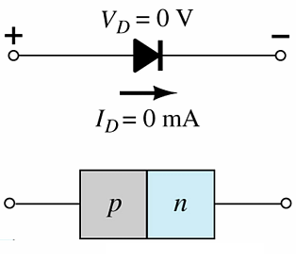
Diode Operating Conditions
No Bias
No external voltage is applied: V_{D} = 0 V
No current is flowing: I_{D} = 0 A
Only a modest depletion region exists

Slide 10
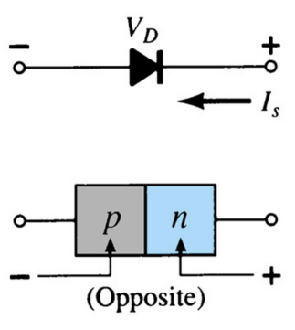
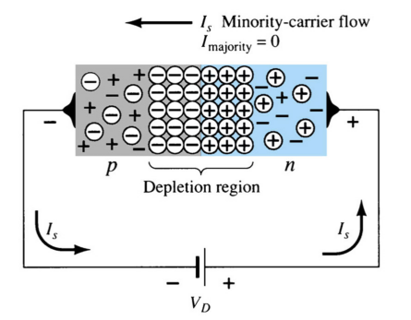
Diode Operating Conditions
Reverse Bias
External voltage is applied across the p-n junction in the opposite polarity of the p- and n-type materials.
The reverse voltage causes the depletion region to widen.
The electrons in the n-type material are attracted toward the positive terminal of the voltage source.
The holes in the p-type material are attracted toward the negative terminal of the voltage source.

Slide 11
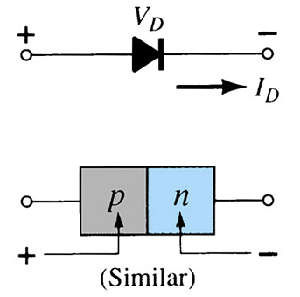
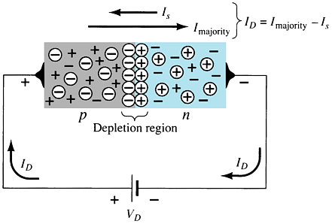
Diode Operating Conditions
Forward Bias
External voltage is applied across the p-n junction in the same polarity as the p- and n-type materials.
The forward voltage causes the depletion region to narrow.
The electrons and holes are pushed toward the p-n junction.
The electrons and holes have sufficient energy to cross the p-n junction.

Slide 12
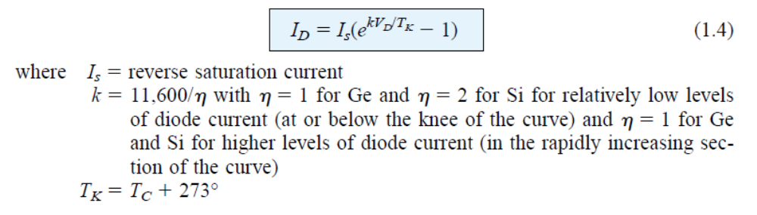
Diode current
The following equation for the forward- and reverse-bias regions:

Slide 13
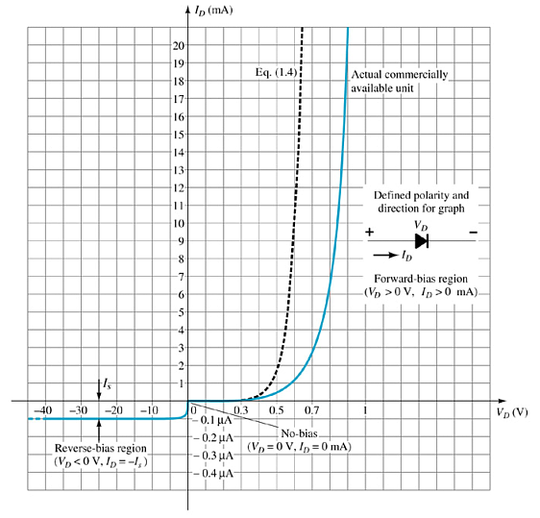
Actual Diode Characteristics
Note the regions for no bias, reverse bias, and forward bias conditions.
Carefully note the scale for each of these conditions.

Slide 14
Majority and Minority Carriers
Two currents through a diode:
Majority Carriers
The majority carriers in n-type materials are electrons.
The majority carriers in p-type materials are holes.
Minority Carriers
The minority carriers in n-type materials are holes.
The minority carriers in p-type materials are electrons.

Slide 15
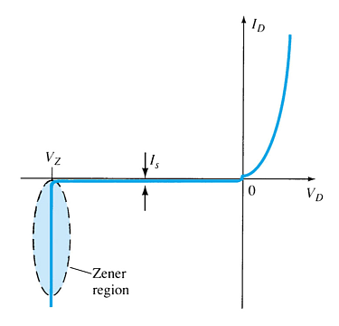
Zener Region
The Zener region is in the diode’s reverse-bias region.
At some point the reverse bias voltage is so large the diode breaks down and the reverse current increases dramatically.
The maximum reverse voltage that won’t take a diode into the zener region is called the peak inverse voltage or peak reverse voltage.
The voltage that causes a diode to enter the zener region of operation is called the zener voltage (V_{Z}).

Slide 16
Forward Bias Voltage
The point at which the diode changes from no-bias condition to forward-bias condition occurs when the electrons and holes are given sufficient energy to cross the p-n junction. This energy comes from the external voltage applied across the diode.
The forward bias voltage required for a:
  gallium arsenide diode ≅ 1.2 V
  silicon diode ≅ 0.7 V
  germanium diode ≅ 0.3 V

Slide 17
Temperature Effects
As temperature increases it adds energy to the diode.
It reduces the required forward bias voltage for forward-bias conduction.
It increases the amount of reverse current in the reverse-bias condition.
It increases maximum reverse bias avalanche voltage.
Germanium diodes are more sensitive to temperature variations than silicon or gallium arsenide diodes.

Slide 18
Resistance Levels
Semiconductors react differently to DC and AC currents.
There are three types of resistance:
• DC (static) resistance
• AC (dynamic) resistance
• Average AC resistance

Slide 19
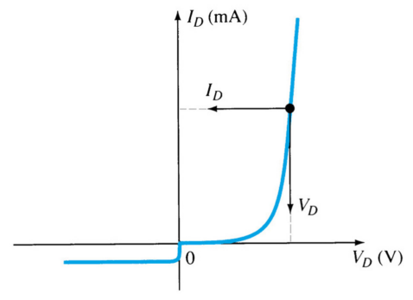
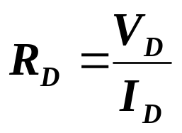
DC (Static) Resistance
For a specific applied DC voltage V_{D}, the diode has a specific current I_{D}, and a specific resistance R_{D}.

Slide 20
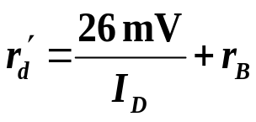

AC (Dynamic) Resistance
In the forward bias region:
The dynamic resistance can be found simply by substituting the quiescent value of the
diode current into the equation.
The resistance depends on the amount of current (I_{D}) in the diode.
The voltage across the diode is fairly constant (26 mV for 25°C).
r_{B} ranges from a typical 0.1 Ω for high power devices to 2 Ω for low power, general purpose diodes. In some cases r_{B} can be ignored.
In the reverse bias region:
The resistance is effectively infinite. The diode acts like an open.

Slide 21
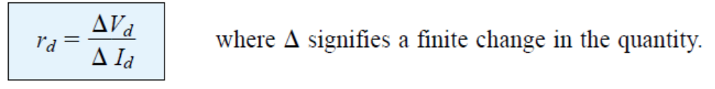
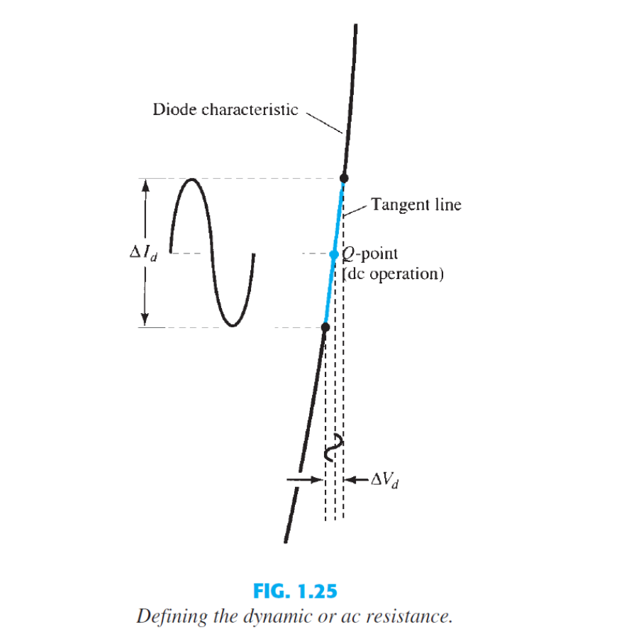
AC (Dynamic) Resistance

Slide 22
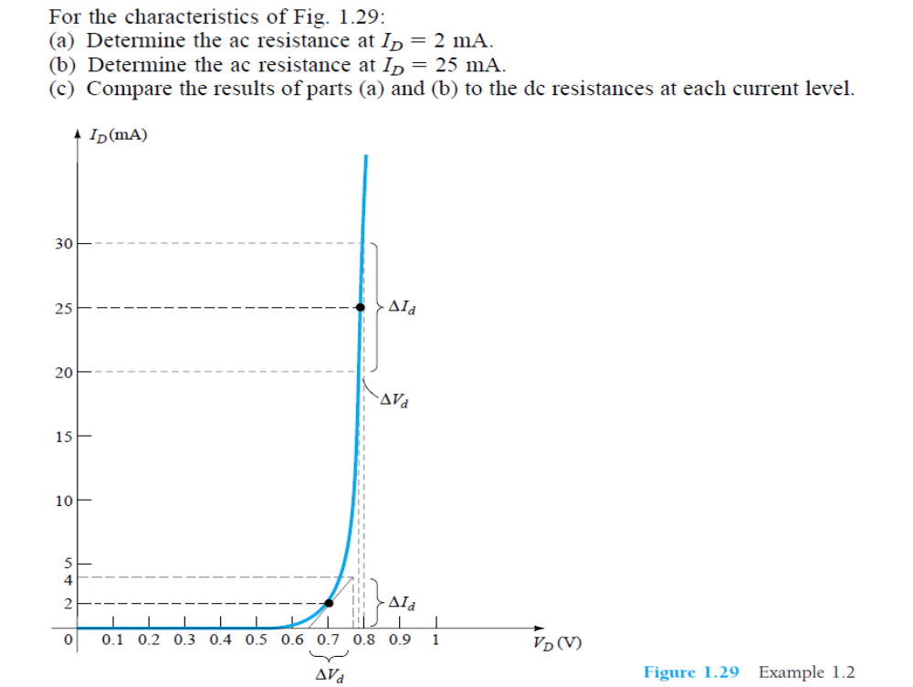
Example:

Slide 23
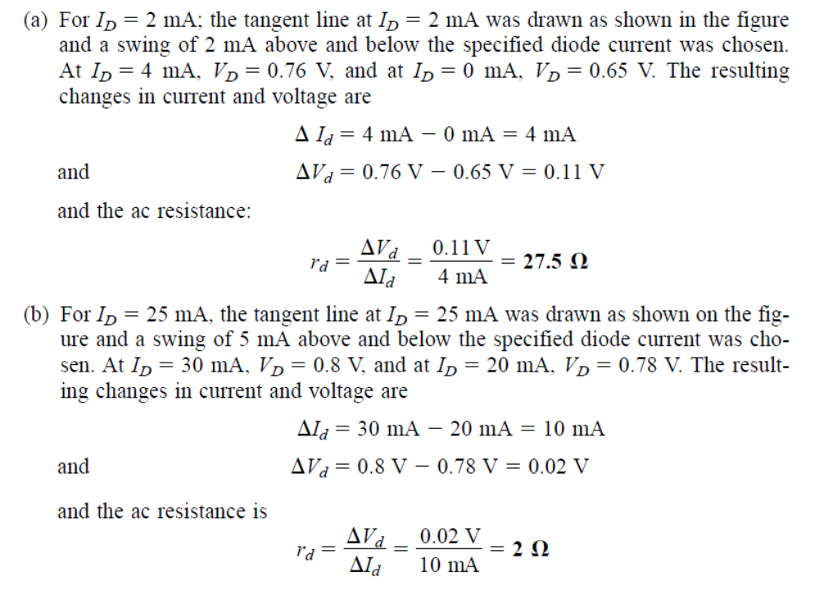

Slide 24
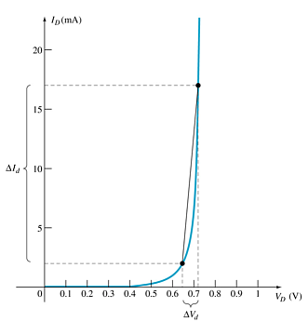
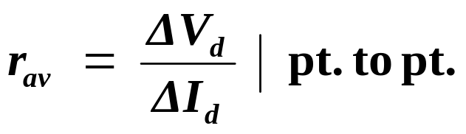
Average AC Resistance
AC resistance can be calculated using the current and voltage values for two points on the diode characteristic curve.

Slide 25
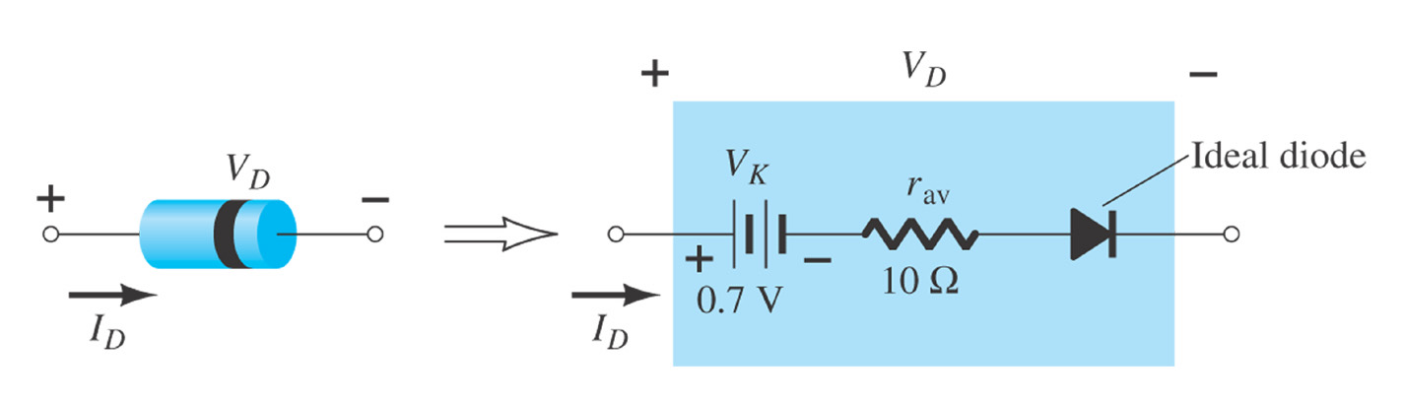
Diode Equivalent Circuit

Slide 26
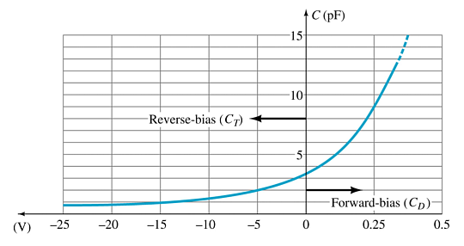
Diode Capacitance
In reverse bias, the depletion layer is very large. The diode’s strong positive and negative polarities create capacitance, C_{T}. The amount of capacitance depends on the reverse voltage applied.
In forward bias storage capacitance or diffusion capacitance (C_{D}) exists as the diode voltage increases.

Slide 27
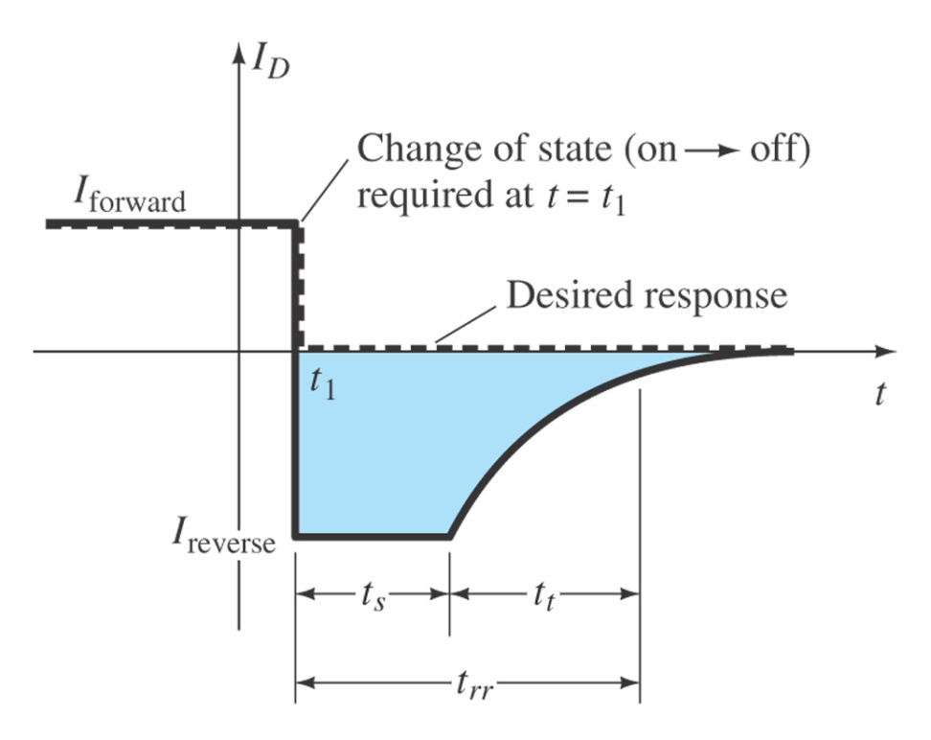
Reverse Recovery Time (t_{rr})
Reverse recovery time is the time required for a diode to stop conducting once it is switched from forward bias to reverse bias.

Slide 28
Diode Specification Sheets
Data about a diode is presented uniformly for many different diodes. This makes cross-matching of diodes for replacement or design easier.
Forward Voltage (V_{F}) at a specified current and temperature
Maximum forward current (I_{F}) at a specified temperature
Reverse saturation current (I_{R}) at a specified voltage and temperature
Reverse voltage rating, PIV or PRV or V(BR), at a specified temperature
Maximum power dissipation at a specified temperature
Capacitance levels
Reverse recovery time, t_{rr}
Operating temperature range

Slide 29
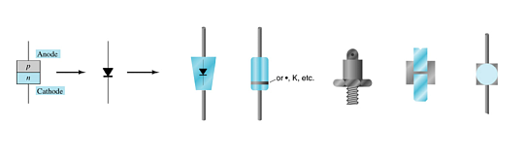
Diode Symbol and Packaging
The anode is abbreviated A
The cathode is abbreviated K

Slide 30
Diode Testing
Diode checker
Ohmmeter
Curve tracer

Slide 31
Diode Checker
Many digital multimeters have a diode checking function.
The diode should be tested out of circuit.
A normal diode exhibits its forward voltage:
Gallium arsenide ≅ 1.2 V
Silicon diode ≅ 0.7 V
Germanium diode ≅ 0.3 V

Slide 32
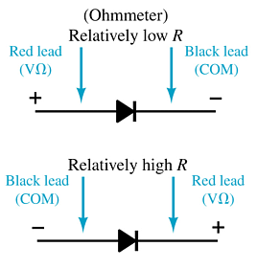
Ohmmeter
An ohmmeter set on a low Ohms scale can be used to test a diode. The diode should be tested out of circuit.

Slide 33
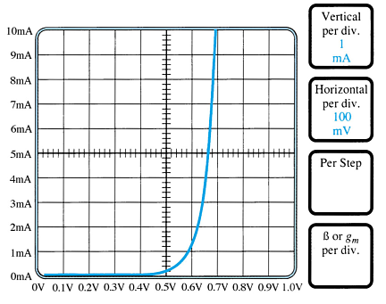
Curve Tracer
A curve tracer displays the characteristic curve of a diode in the test circuit. This curve can be compared to the specifications of the diode from a data sheet.

Slide 34
Other Types of Diodes
Zener diode
Light-emitting diode
Diode arrays

Slide 35

Zener Diode
A Zener is a diode operated in reverse bias at the Zener voltage (V_{Z}).
Common Zener voltages are between 1.8 V and 200 V

Slide 36

Light-Emitting Diode (LED)
An LED emits photons when it is forward biased.
These can be in the infrared or visible spectrum.
The forward bias voltage is usually in the range of 2 V to 3 V.

Slide 37
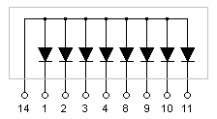

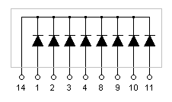
Diode Arrays
Multiple diodes can be packaged together in an integrated circuit (IC).
Common Anode
A variety of combinations exist.
Common Cathode

